Slide 1
DERIVATIVES
CHAPTER 2

Slide 2
CONTENTS
3.1 Defining the Derivative
3.2 The Derivative as a Function
3.3 Differentiation Rules
3.4 Derivatives as Rates of Change
3.5 Derivatives of Trigonometric Functions
3.6 The Chain Rule
3.8 Implicit Differentiation
3.9 Derivatives of Exponential and Logarithmic Functions

Slide 3
Chapter 3: DERIVATIVES
3.1 Defining the Derivatives
Notes:
The slope of tangent line as the limit of slopes of secant lines
Physical examples of instantaneous rates of change and their unit.
The derivative notation f’(a) and meaning of its.
Using f’ to write an equation of the tangent line to a curve at a given point.
Using f’ as an approximate rate of change when working with discrete data.

Slide 4
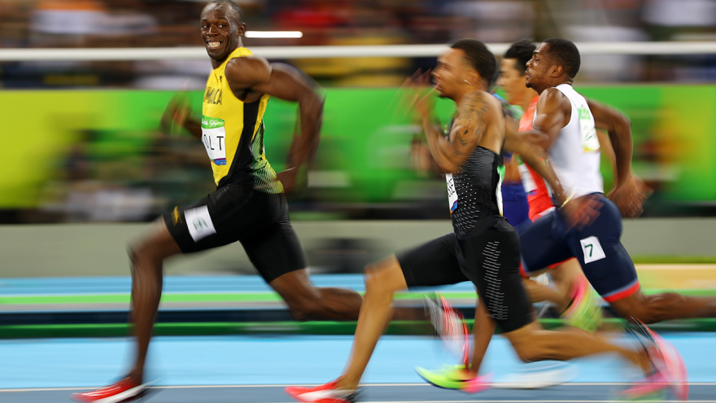
Velocity problem
Before calculus With calculus
Average velocity instantaneous velocity
Usain Bolt in 2009:
100-meter per 9.58-second
Average speed: 10.44 m/s
Top speed: 12.27 metres per second
How to compute?

Slide 5



Definition of derivative
How to find instantaneous velocity at a?
Starting point
a
a+h
f(a)
f(a+h)
Rate of change = $\frac{change in displacement}{change in time}$

Slide 6
is called the derivative of f at a.
Read: “The derivative of f with respect to x is …”
f’(x): “f prime x”

Slide 7
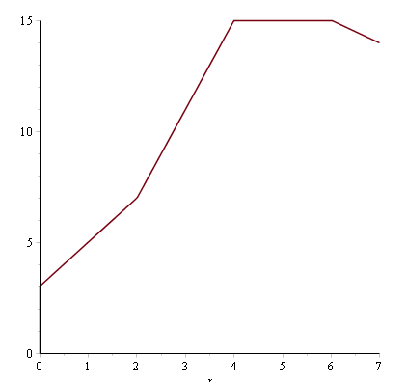
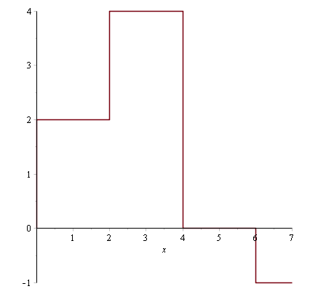
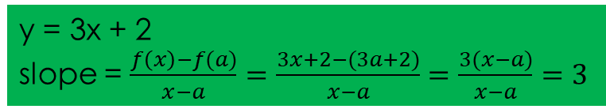
Slope of a line
f(x)
m = slope of the line y = mx + b
f(x) – f(a)
x-a
f’(x)
y = 3x + 2
slope = $\frac{f\left(x\right)−f(a)}{x−a}=\frac{3x+2−(3a+2)}{x−a}=\frac{3(x−a)}{x−a}=3$

Slide 8
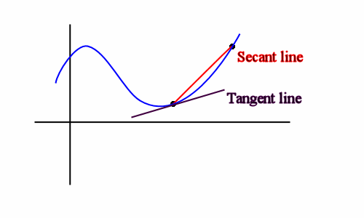
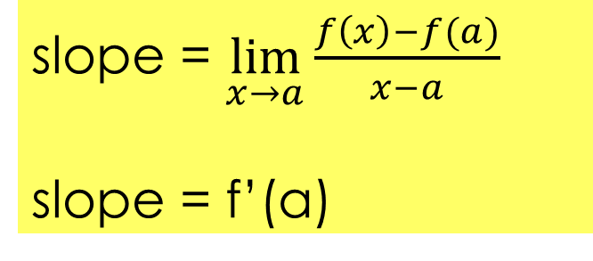
Slope of a curve - Tangent line
How to find the slope of a curve y = f(x) (not a line)?
f’(a) = slope of tangent line to the curve at x = a
Slope of the curve = slope of the tangent line at x = a.
slope = $\lim_{x→a}{\frac{f\left(x\right)−f(a)}{x−a}}$
slope = f’(a)
a
x
Notes:
Use Maple to illustrate.

Slide 9
TANGENTS
Definition
The tangent line to the curve y = f(x) at the point P(a, f(a)) is the line through P with slope
provided that this limit exists.

Slide 10
Example 3.1
Find the equation of the line tangent to the graph of f (x) = x² at x = 3 .
Solution: First find the slope of the tangent line
Next, find a point on the tangent line. Since the line is tangent to the graph of f (x) at x = 3, it passes through the point ( 3, f (3)) = (3, 9).
we obtain the line: y - 9 = 6(x - 3).

Slide 11
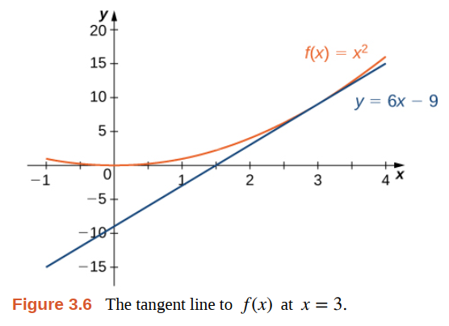
Example 3.1

Slide 12
VELOCITIES
Definition
We define the velocity (or instantaneous velocity) v(a) at time t = a to be the limit of these average velocities:

Slide 13
VELOCITIES
EXAMPLE. Suppose that a ball is dropped from the upper observation deck of the CN Tower, 450 m above the ground.
(a) What is the velocity of the ball after 5 seconds?
(b) How fast is the ball traveling when it hits the ground?
SOLUTION. We will need to find the velocity both when and when the ball hits the ground, so it’s efficient to start by finding the velocity at a general time t=a. Using the equation of motion s=f(t)=4.9t², we have

Slide 14
VELOCITIES
The velocity after 5s is v(5) = (9.8)(5) = 49m/s
(b) Since the observation deck is 450 m above the ground, the ball will hit the ground at the time t₁ when s(t₁) = 450, that is,
The velocity of the ball as it hits the ground is therefore

Slide 15
DERIVATIVES
Definition
The derivative of a function f at a number a, denoted by f’(a), is:
if this limit exists. Or
Notes:
Meaning of f’(a)?

Slide 16
DERIVATIVES
EXAMPLE 4. Find the derivative of the function
at the number a.
SOLUTION. From Definition we have
Notes:
Meaning of f’(a)?

Slide 17
DERIVATIVES
3.2 The Derivative as a Function
Notes:
The concept of a differentiable function interpreted graphically, algebraically and descriptive.
Obtaining the derivative function f’ by first considering the derivative at a point a and then a:= a variable such as x.
How a function can fail to be differentiable.
Second and higher derivatives.

Slide 18
DERIVATIVES
In the preceding section, we considered the derivative of a function f at a fixed number a:
If we replace a in Equation 1 by a variable x, we obtain:
Notes:
f‘(a) is a number; f’(x) is a function

Slide 19
OTHER NOTATIONS
Some common alternative notations for the derivative are as follows:
The symbols D and d/dx are called differentiation operators.
The symbol dy/dx is called Leibniz notation

Slide 20
OTHER NOTATIONS
If we want to indicate the value of a derivative dy/dx in Leibniz notation at a specific number a, we use the notation
which is a synonym for f’(a).

Slide 21
OTHER NOTATIONS
Definition
A function f is differentiable at a if f’(a) exists.
It is differentiable on an open interval D if it is differentiable at every number in the interval D.

Slide 22
HOW CAN A FUNCTION FAIL TO BE DIFFERENTIABLE?
Theorem
If f is differentiable at a, then f is continuous at a.
This theorem states that, if f is not continuous at a, then f is not differentiable at a.
Notes:
“<=“ is false: y = |x| is continuous at 0 but it is not differentiable at 0.

Slide 23
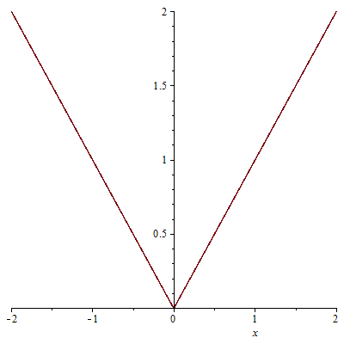
differentiable
f’(a) exists ➔ f is differentiable at a
Differentiable at a ➔ continuous at a (ALWAYS TRUE)
Continuous at a ➔ differentiable ? (NOT ALWAYS TRUE)
FOR EXAMPLE.
y = |x|is continuous at x = 0 but not differentiable at x = 0.

Slide 24
HIGHER DERIVATIVES
If f is a differentiable function, then its derivative f’ is also a function.
So, f’ may have a derivative of its own, denoted by (f’)’= f’’.
This new function f’’ is called the second derivative of f.

Slide 25
HIGHER DERIVATIVES
The process can be continued.
In general, the nth derivative of f is denoted by f^{(n)} and is obtained from f by differentiating n times.
If y = f(x), we write:

Slide 26
DERIVATIVES
3.3 Differentiation Rules
3.5 Derivatives of Trigonometric functions
3.9 Derivatives of Exponential and Logarithmic functions
Notes:
The computation of derivatives using the power, constant multiple, sum, difference, product and quotient rules.
The normal line to a curve at a point.

Slide 27
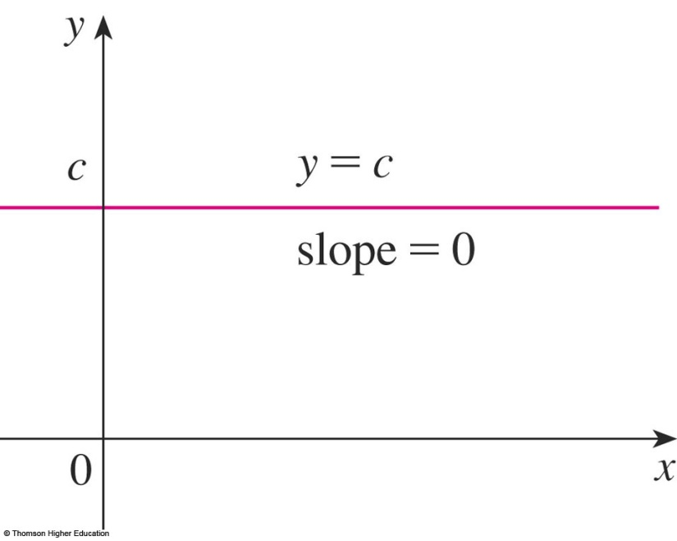
3.3 DIFFERENTIATION RULES
Constant function
In Leibniz notation, we write this rule as follows.
Notes:
e is constant

Slide 28
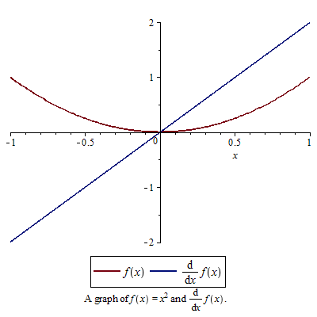

Formulas
f(x) = x²
f’(a) = $\lim_{x→a}{\frac{f\left(x\right)−f(a)}{x−a}}=\lim_{x→a}{\frac{x^{2}−a^{2}}{x−a}}$
$$=\lim_{x→a}\frac{(x−a)(x+a)}{x−a}$$
= $\lim_{x→a}$(x+a) = 2a
So, f’(x) = 2x
(x²)’ = 2x

Slide 29
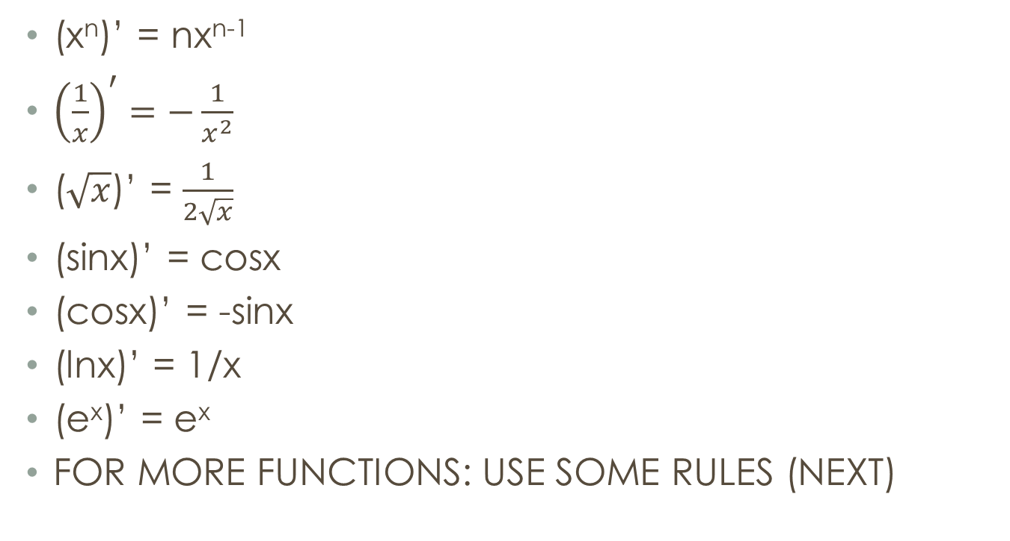
formulas
(x^{n})’ = nx^{n-1}
${\left(\frac{1}{x}\right)}^{′}=−\frac{1}{x^{2}}$
($\sqrt{x}$)’ = $\frac{1}{2\sqrt{x}}$
(sinx)’ = cosx
(cosx)’ = -sinx
(lnx)’ = 1/x
(e^{x})’ = e^{x}
FOR MORE FUNCTIONS: USE SOME RULES (NEXT)
TRY TO REMEMBER!

Slide 30
3.3 DIFFERENTIATION RULES
Differentiation formulas
Here’s a summary of the differentiation formulas we have learned so far.

Slide 31
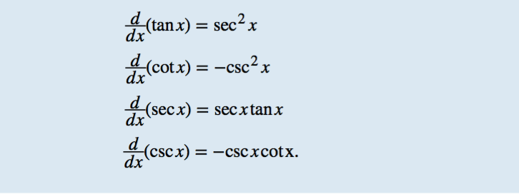

3.5 DERIVATIVES OF TRIGONOMETRIC FUNCTIONS

Slide 32
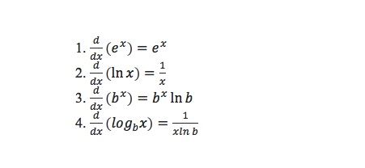
3.9 DERIVATIVES OF EXPONENTIAL AND LOGARITHMIC FUNCTIONS

Slide 33
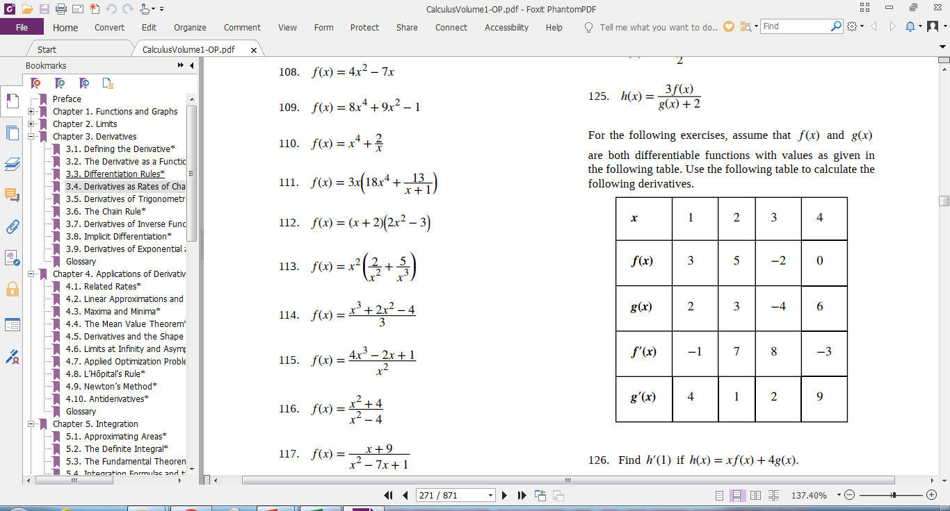
For the following exercises, find f ′(x) for each function.

Slide 34
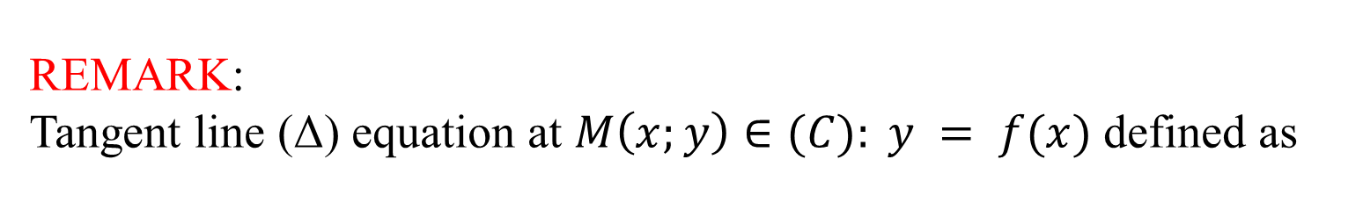
TANGENT AND NORMAL LINES
Example 12
Find equations of the tangent line and normal line to the curve at the point (1, ½).

Slide 35
TANGENT AND NORMAL LINES
Tangent line of the graph of this curve at (1,1/2) is:
© Thomson Higher Education

Slide 36
DERIVATIVES
3.4 Derivatives as Rates of change
Notes:
The concept of a differentiable function interpreted graphically, algebraically and descriptive.
Obtaining the derivative function f’ by first considering the derivative at a point a and then a:= a variable such as x.
How a function can fail to be differentiable.
Second and higher derivatives.

Slide 37
DERIVATIVES
Definition
Let s(t) be a function giving the position of an object at time t.
The velocity of the object at time t is given by v(t) = s′ (t).
The speed of the object at time t is given by |v(t)|.
The acceleration of the object at t is given by
a(t) = v′ (t) = s″(t).

Slide 38
Find velocity, acceleration
Ex. The position of a particle is given by the equation
s(t) = t³ – 6t² + 9t, where t is measured in seconds and s in meters.
What is the velocity at the time t and after 2s?
Find the acceleration at time and after 4s.
Solution.
Velocity = v(t) = s’(t) = 3t² – 12t + 9 ➔ v(2) = -3 m/s
Acceleration = a(t) = v’(t) = 6t – 12 ➔ a(4) = 12 m/s².

Slide 39
Do yourself
(position function)’ = velocity
(velocity)’ = acceleration
DO YOURSELF:
A particle moves with position function
s(t) = t⁴ – 3t³ -20t² + 20t, (t ≥ 0)
(a) At what time does the particle have a velocity of 20 m/s?
(b) At what time is the acceleration 0?

Slide 40
Example.
The position of a particle is given by the equation where is measured in seconds and in meters.
s = f(t) = t³-6t² + 9t
(a) Find the velocity at time t.
(b) What is the velocity after 2 s? After 4 s?
(c) When is the particle at rest?
(d) When is the particle moving forward?
(e) Find the acceleration at time and after 4 s.
(f) When is the particle speeding up? When is it slowing down?

Slide 41
Solution (a) The velocity function is the derivative of the position function.
(b) The velocity after 2s means the instantaneous velocity when t = 2, that is,
The velocity after 4 s is

Slide 42
Solution (c) The particle is at rest when v(t) = 0, that is.
Thus the particle is at rest after 1 s and after 3s. (d) The particle moves in the positive direction when v(t) > 0, that is,
Thus the particle moves in the positive direction in the time intervals t<1 and t>3. It moves backward (in the negative direction) when 1<t<3.

Slide 43
Solution (e) The acceleration is the derivative of the velocity function:
(f) The particle speeds up when the velocity is positive and increasing (v are both positive) and also when the velocity is negative and decreasing (v are both negative). In other words, the particle speeds up when the velocity and acceleration have the same sign.
The particle slows down when v and a have opposite signs, that is, when and when 2<t<3.

Slide 44
Example. Position and Velocity
The position of a particle moving along a coordinate axis is given by s(t) = t³ - 9t² + 24t + 4, t ≥ 0.
Find v(t).
At what time(s) is the particle at rest?
On what time intervals is the particle moving from left to right? From right to left?

Slide 45
Solution a. The velocity is the derivative of the position function: v(t) = s′ (t) = 3t² - 18t + 24.
b. The particle is at rest when v(t) = 0, so set
3t² - 18t + 24 = 0 ⬄ t=2, t=4.
we find that the particle is at rest at t = 2 and t = 4.

Slide 46
Solution c. The particle is moving from left to right when v(t) > 0 and from right to left when v(t) < 0.
3t² - 18t + 24 > 0 on [0, 2) ∪ (4, +∞),
the particle is moving from left to right on these intervals.
3t² - 18t + 24 < 0 on (2, 4),
the particle is moving from right to left on this interval.

Slide 47
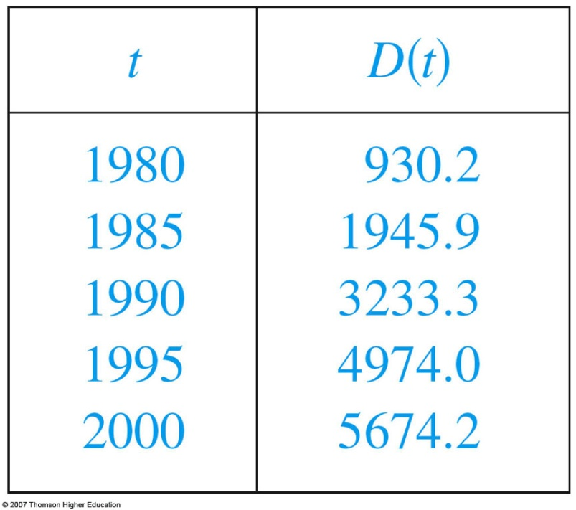
RATES OF CHANGE
Example
Let D(t) be the US national debt at time t. The table gives approximate values of this function by providing end-of-year estimates, in billions of dollars, from 1980 to 2000. Interpret and estimate the value of D’(1990).
The derivative D’(1990) means the rate of change of D with respect to t when t =1990, that is, the rate of increase of the national debt in 1990.

Slide 48
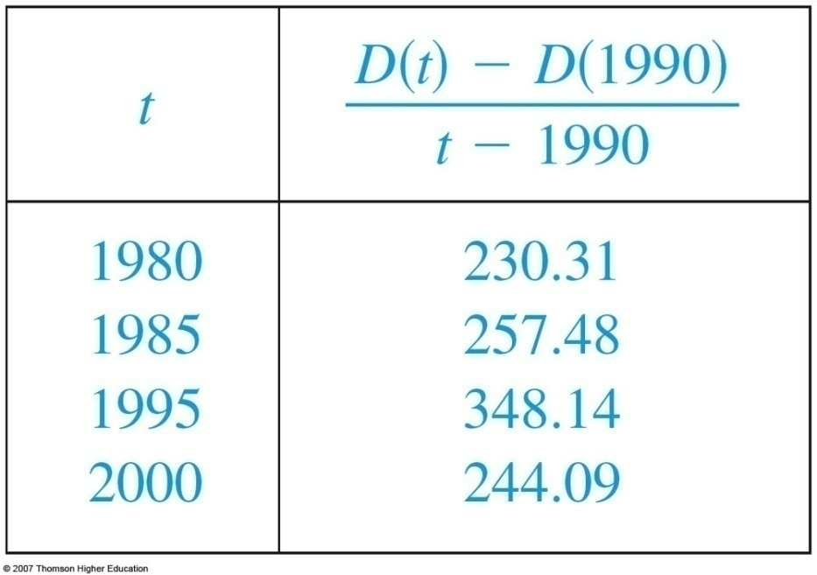

RATES OF CHANGE
Example
By Equation 5,
So, we compute and tabulate values of the difference quotient as follows.
Notes:
Using f’ as an approximate rate of change when working with discrete data.

Slide 49

RATES OF CHANGE
Example
We estimate that the rate of increase of the national debt in 1990 was the average of these two numbers—namely billion dollars per year.

Slide 50
Changes in Cost and Revenue
Definition
If C(x) is the cost of producing x items, then the marginal cost MC(x) is MC(x) = C′ (x).
If R(x) is the revenue obtained from selling x items, then the marginal revenue MR(x) is MR(x) = R′ (x).
If P(x) = R(x) - C(x) is the profit obtained from selling x items, then the marginal profit MP(x) is defined to be MP(x) = P′ (x) = MR(x) - MC(x) = R′ (x) - C′ (x).

Slide 51

Changes in Cost and Revenue
Example: Given
find each of the following:
a) Total profit, P(x).
b) Total cost, revenue, and profit from the
production and sale of 50 units of the product.
c) The marginal cost, revenue, and profit when 50
units are produced and sold.

Slide 52
Changes in Cost and Revenue
Solution:
a)
b)

Slide 53
Example(concluded):
c)
So, when 50 units have been made, the approximate
cost of the 51st unit will be $6200, and the approximate
revenue from the sale of the 51st unit will be $6340 for
an approximate profit on the 51st unit of $140.

Slide 54
DERIVATIVES
3.6
The chain rule
Notes:
The concept of a differentiable function interpreted graphically, algebraically and descriptive.
Obtaining the derivative function f’ by first considering the derivative at a point a and then a:= a variable such as x.
How a function can fail to be differentiable.
Second and higher derivatives.

Slide 55
THE CHAIN RULE
If g is differentiable at x and f is differentiable at g(x), the composite function F = f ◦ g is differentiable at x and F’ is given by the product:
F’(x) = f’(g(x)) • g’(x)
In Leibniz notation, if y = f(u) and u = g(x) are both differentiable functions, then:
Notes:
dy/dx is y’ dependent on x
dy/du is y’ dependent on u
du/dx is u’ dependent on x
“/” is not division.

Slide 56
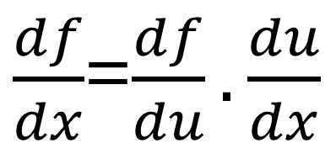

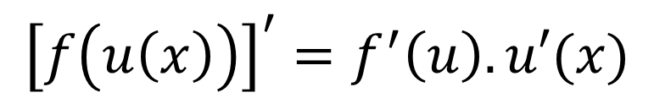
The chain rule
f(u(x))
Example .
[sin(x²)]’= cos(x²).2x
f
u(x)
f’
u(x)
u’(x)
$\frac{df}{dx}$=$\frac{df}{du}.\frac{du}{dx}$
$${\left[f\left(u\left(x\right)\right)\right]}^{′}=f^{′}\left(u\right).u′(x)$$
$${\left[(f□u)(x)\right]}^{′}=f^{′}\left(u\right).u′(x)$$

Slide 57
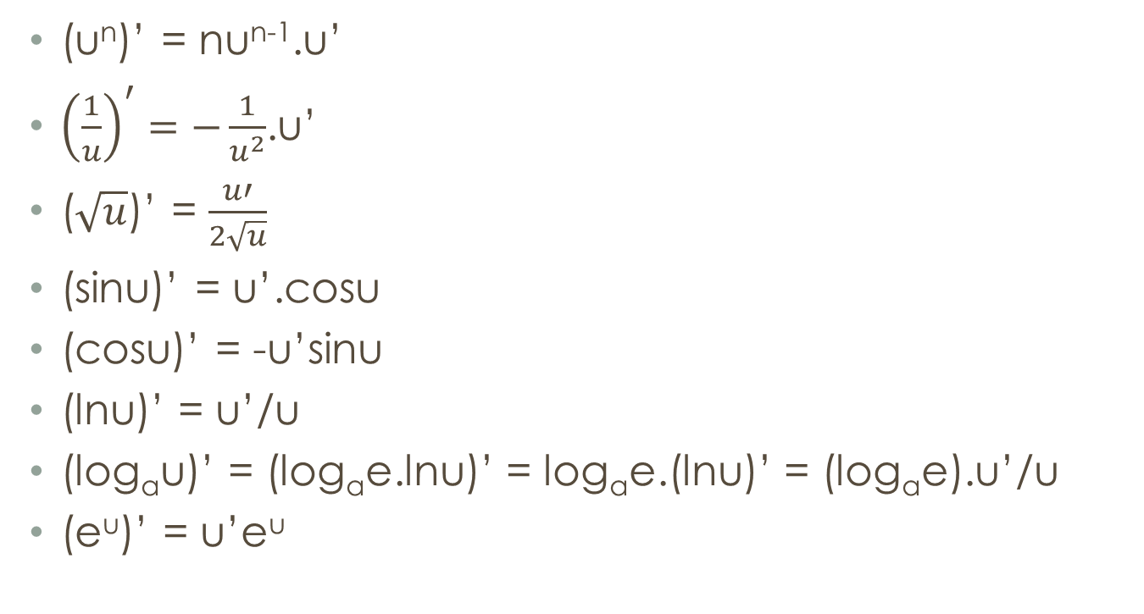
Formulas (from chain rule)
(u^{n})’ = nu^{n-1}.u’
${\left(\frac{1}{u}\right)}^{′}=−\frac{1}{u^{2}}$.u’
($\sqrt{u}$)’ = $\frac{u′}{2\sqrt{u}}$
(sinu)’ = u’.cosu
(cosu)’ = -u’sinu
(lnu)’ = u’/u
(log_{a}u)’ = (log_{a}e.lnu)’ = log_{a}e.(lnu)’ = (log_{a}e).u’/u
(e^{u})’ = u’e^{u}
TRY TO REMEMBER AND USE!

Slide 58
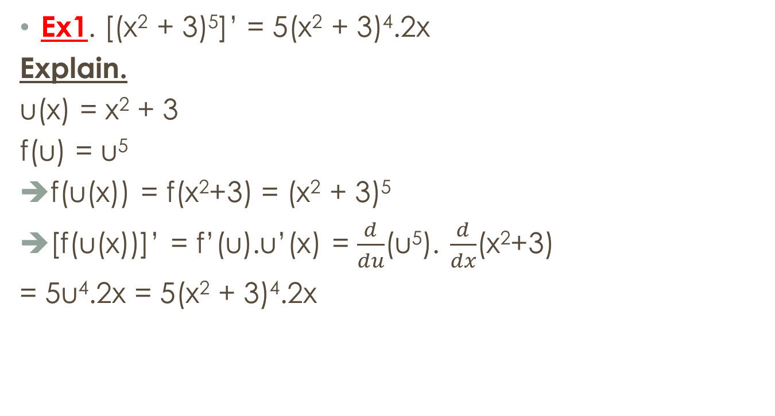
The chain rule-examples
(u^{n})’ = nu^{n-1}.u’
Ex1. [(x² + 3)⁵]’ = 5(x² + 3)⁴.2x
Explain.
u(x) = x² + 3
f(u) = u⁵
f(u(x)) = f(x²+3) = (x² + 3)⁵
[f(u(x))]’ = f’(u).u’(x) = $\frac{d}{du}$(u⁵). $\frac{d}{dx}$(x²+3)
= 5u⁴.2x = 5(x² + 3)⁴.2x
f(u(x))

Slide 59

The chain rule - examples
Solution.
F(x) = f(g(x)) // F = f□g
➔ F’(x) = f’(g(x)).g’(x)
F’(5) = f’(g(5)).g’(5)
= f’(-2).6
= 4.6 = 24

Slide 60
Example.
Find the derivative of

Slide 61
Let f(x)=g(sin3x). Find f ’ in terms of g’.
A | 3cos3xg’(x)
B | 3cos3xg’(sin3x)
C | cos3xg’(sin3x)
Answer: b

Slide 62
Suppose h(x)=f(g(x)) and f(2)=3, g(2)=1, g’(2)=1, f’(2)=2, f’(1)=5. Find h’(2).
A | 1
B | 2
C | 3
D | 4
E | 5
Answer: e

Slide 63
DERIVATIVES
3.8
Implicit Differentiation

Slide 64
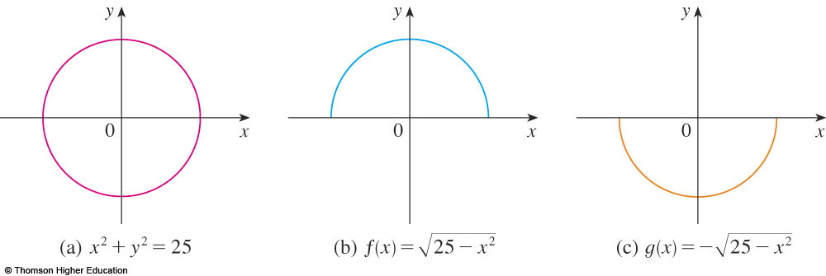
IMPLICIT DIFFERENTIATION
The graphs of f and g are the upper and lower semicircles of the circle x² + y² = 25.
Notes:
What is implicit function?
The technique of implicit differentiation

Slide 65
IMPLICIT DIFFERENTIATION METHOD
Instead, we can use the method of implicit differentiation.
This consists of differentiating both sides of the equation with respect to x and then solving the resulting equation for y’.

Slide 66
IMPLICIT DIFFERENTIATION
Example 1
a. If x² + y² = 25, find .
b. Find an equation of the tangent to the circle x² + y² = 25 at the point (3, 4).

Slide 67
IMPLICIT DIFFERENTIATION
Example 1 a
Remembering that y is a function of x and using the Chain Rule, we have:
Then, we solve this equation for :

Slide 68
IMPLICIT DIFFERENTIATION
E. g. 1 b—Solution 1
At the point (3, 4) we have x = 3 and y = 4.
So,
Thus, an equation of the tangent to the circle at (3, 4) is: y – 4 = – ¾(x – 3) or 3x + 4y = 25.

Slide 69
IMPLICIT DIFFERENTIATION
Example 4
Find y” if x⁴ + y⁴ = 16.
Differentiating the equation implicitly with respect to x, we get 4x³ + 4y³y’ = 0.

Slide 70
IMPLICIT DIFFERENTIATION
E. g. 4—Equation 3
Solving for y’ gives:

Slide 71
IMPLICIT DIFFERENTIATION
Example 4
To find y’’, we differentiate this expression for y’ using the Quotient Rule and remembering that y is a function of x:

Slide 72
IMPLICIT DIFFERENTIATION
Example 4
If we now substitute Equation 3 into this expression, we get:

Slide 73
IMPLICIT DIFFERENTIATION
Example 4
However, the values of x and y must satisfy the original equation x⁴ + y⁴ = 16.
So, the answer simplifies to:

Slide 74
Summary
Derivatives and slope of tangent lines
Definition of derivative
Symbols
Rules for computing derivatives
The chain rule

Slide 75
THANKS

